Slide 1
Applied Mathematics
Computer engineering Department
lecture Seven
Alternating Series
The series:
∞
∑(−1)^{𝑛} 𝑎_{𝑛} = 𝑎₀ − 𝑎₁ + 𝑎₂ − 𝑎₃ + 𝑎₄ − ⋯
𝑛=0
(−1) = cos(𝑛𝜋)
-1 for n odd
1 for n even
The Convergence Test of Alternating Series
1. take the absolute value of the nth term and use tests methods to check it.
2. If |an| is conv.
absolutely Conv.
If |an| is Div., then check 1) lim 𝑎_{𝑛}=0
𝑛→∞
the series is decreasing.
All terms of the series are positive. (conditionally Conv.)
Ex (1):
∞
(𝑛!)²
∑(−1)^{𝑛+1} _{(2𝑛)!}
𝑛=1

Slide 2
Applied Mathematics
Computer engineering Department
lecture Seven
(𝑛!)²
^{|an|=}(2𝑛)!
2
((𝑛+1)!)
(2𝑛)!
1
4
By Ratio test
ρ= lim
∗ ₂ =
< 1
𝑛→∞ (2𝑛+1)!
(𝑛!)
So ,Conv. absolutely Conv.
Ex (2):
∞
_{𝑛}2
∑(−1)^{𝑛} _{𝑛2 + 1}
𝑛=0
_{𝑛}2
|an|=_{𝑛2+1}
lim
_{𝑛}2
= 1 ≠ 0
Div.
𝑛→∞ 𝑛²+1
lim an ≠ 0
Div.
𝑛→∞
Ex (3):
∞
∑(−1)^{𝑛}
𝑛=2
ln 𝑛 ln 𝑛⁷
ln 𝑛 ln 𝑛
^{|an|=}ln 𝑛⁷ ⁼ 7 ln 𝑛 ⁼
1
7
, lim
ln 𝑛
1
؞ Div.
ln 𝑛
7
= ₇ ≠ 0
𝑛→∞
lim an ≠ 0
؞ Div.
𝑛→∞

Slide 3
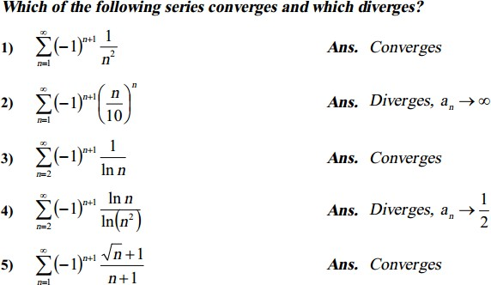
Applied Mathematics
Computer engineering Department
lecture Seven
Homework
6)
∑∞
(𝑐𝑜𝑠𝑛𝜋)
𝑛
Ans.
Diverges
𝑛=0
3𝑛+1
7)
∑∞
(−1)^{𝑛+1}
𝑛
Ans.
Absolut Converges
𝑛=1
𝑛³+1

